Slide 1

Parental Oversharing: Investigating “Sharenting Concerns”
in the Digital Age
Notes:
Hello everyone, I am Manila and this is Sharmin. Today we will be presenting our project on parental oversharing- investigating sharenting concerns in the digital age.

Slide 2
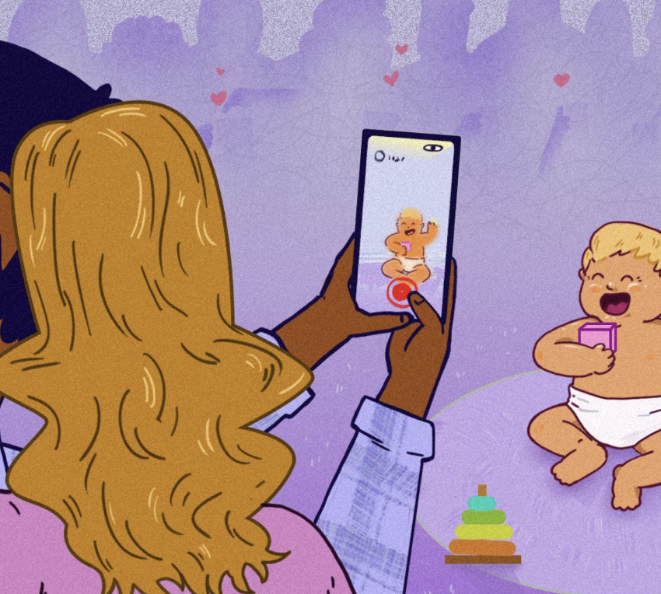
What is Sharenting?
“Parents sharing information about their children, including photos, videos, and personal details, on social media platforms.”
Notes:
To begin with, we want to discuss what exactly sharenting means. The origins of the term "sharenting" have been attributed to the Wall Street Journal. Which denotes the action of parents sharing photos, videos. Or any personal details of their children on social media platforms

Slide 3
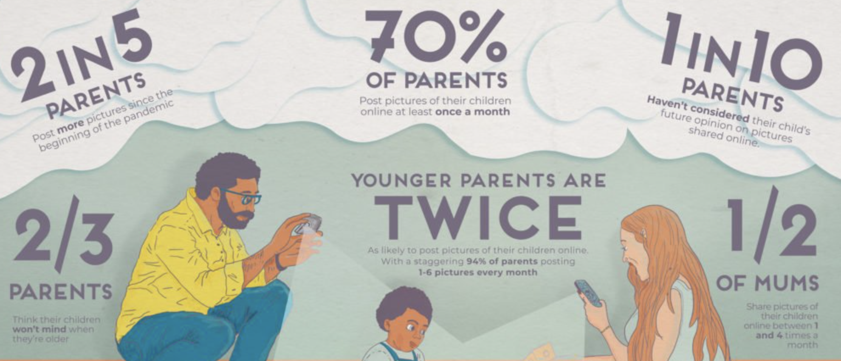
How often are parents posting pictures of their children online?
Credits: https://www.pixsy.com/image-theft/over-share-nting-risks
Notes:
So, It is not that uncommon to share about your kids even before social media existed. All of our parents have bragged about our success at one point or another. But with social media the concern is only growing bigger. Let us look at why we need to discuss Sharenting. Recent survey study have shown, about 70% of parents were regularly uploading pictures of their children online, with 1 in 10 admitting they had not even considered their child’s future opinion at all.

Slide 4
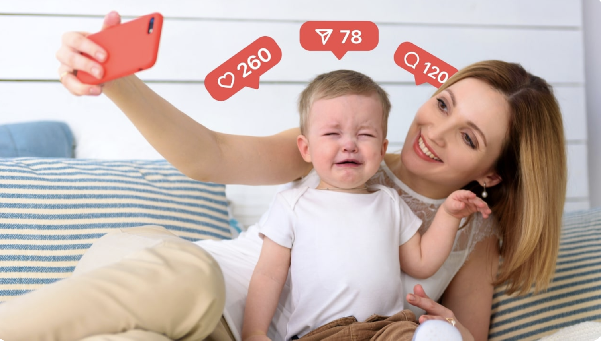
WHY discuss Sharenting?
Digital Footprint and Impact on Children's Well-Being
Cybersecurity and Online Safety
Public Perception and Social Stigma
Guidelines for Responsible Sharing
Legal and Ethical Considerations
Notes:
So, this brings to our next slide, why do we even need to discuss about sharenting, sharenting is increasing the digital footprint of the kids from a really early age, which can have a huge impact of their well being. There is also a concern for their online privacy and security, how other people perceive this act, are there any social stigma around sharenting. These discussion can also help us in making guidelines for informed and responsible sharing. In addition, these will make us understand of any ethical consideration around sharenting

Slide 5
WHY discuss Sharenting?
“When my first was around 16 months I got a message from a guy who messaged me “nice smile on your kid, we love that kind of stuff in my circle, thanks for the content”...I immediately reported everything to the police. My friends, computer program engineers, also traced his IP address and found his location, which happened to be across the country. After a few months I was contacted by the police as a follow up. The guy was going to jail and his computer was seized for child pornography, along with targeting local/non-local children. “
Reddit comment: https://www.reddit.com/r/BabyBumps/comments/drocp1/comment/f6k5sd3/?utm_source=share&utm_medium=web2x&context=3
Notes:
Let me give a disclaimer about our next slide, this slide contains a post snippet that have been collected from reddit that have sensitive comment about children. So here a parent share his/her story about sharing an image of his.her child, where a pedophile commented some very sensitive things. We can only, imagine the mental state of the parent seeing the comment. Luckily, after reporting, The guy ended up in jail for having child pornography. This story tells a lot about why this study is important

Slide 6
Research Goals
RQ1
What are the reasons behind sharing and not sharing?
RQ2
What are the primary concerns about Sharenting on Reddit platform?
RQ3
How do parents on Reddit perceive the potential long-term consequences of their sharenting practices?
RQ4
What strategies are being employed to deal with sharenting?
Notes:
What are the reasons behind sharing and not sharing?
What are the main concerns and possibly suggested solutions to the same?
How do parents on Reddit perceive the potential long-term consequences of their sharenting practices?
What strategies are being employed to deal with sharenting?

Slide 7
Data Collection
Subreddits
Search Tags
60 Posts
r/parenting
r/ScienceBasedParenting
r/childrenoftiktok
r/BabyBumps
Social Media
Social Media Post
Sharenting
Sharing on Social media
Upvotes
Post Flairs
Timestamp
No. of comments
Top 10 Comments
Notes:
For our data collection, we first investigated which subreddits have most discussion on sharenting and identified, these parenting, sciencebasedparenting, childrenof tiktok and babybumps to be most popular, in there subreddits we used these search tags, social media, social media post, sharenting, sharing on social media to manually collect the post related to sharenting discussion. We have collected 60 post with from reddit, with their top 10 comments with upvote and timestamp of the post

Slide 8
Methodology
Qualitative Coding
60 post & top 10 comments
per post
Iterative coding
Theme Generation
Independent Coding
Discussion
20 Posts & related comments
each
Notes:
Our full methodology is divided into 3 parts, we first randomly selected 40 post from our collected 60 posts, and then we divided 20 posts with 10 comments to between us for qualitative coding process. For our qualitative coding we first independently coded our parts and then discussed our findings. Our initial code represented quite similarities. Based on our discussion we iteratively went back and forth to improve and align the codes and ultimately extracted the themes.

Slide 9
RQ1: Why do parents share?
❝ I post my kids on social media. I have International Family and friends in other states. They see our life, comment, and do so on their own time zone. ❞
Share with family and friends
Social pressure
Risk Outweighs benefits
❝ I am aware there are risks, but I value the connection it makes and am willing to take some risks to maintain the connections we have.❞
Notes:
Our first theme is why parents share or not share. We found that most parents share pictures of their children for their family. Some said sharenting help them get connected with their familys and share their joy. But we also noticed some interesting things. Some parents feel pressure maintaining social image and follow the norms. Here is comment where a husband shares that the wife insists on sharenting because of social norms. But are they not aware of the risk like we shared the story earlier. Some parents feel the risks outweigh the benefits. Here is a quote - a parent comments “I am aware there are risks, but I value the connection it makes and am willing to take some risks to maintain the connections we have.”

Slide 10
RQ2: What are the concerns with Sharenting?
Unauthorized Sharing by Grandparents
Security of the Child
Digital footprint without child's consent
Insecurity about parenting
❝ I want my child to have full autonomy over their identity and presence, and only when they are mature enough to handle it.❞
❝ The chances are small but I just don’t want my child’s identity/likeness used for abuse or something perverted.❞
Notes:
Our first theme is why parents share or not share. We found that most parents share pictures of their children for their family. Some said sharenting help them get connected with their familys and share their joy. But we also noticed some interesting things. Some parents feel pressure maintaining social image and follow the norms. Here is comment where a husband shares that the wife insists on sharenting because of social norms. But are they not aware of the risk like we shared the story earlier. Some parents feel the risks outweigh the benefits. Here is a quote - a parent comments “I am aware there are risks, but I value the connection it makes and am willing to take some risks to maintain the connections we have.”

Slide 11
RQ3: What are the Long-term consequences?
Impact on personality shaping
Over reliance on social media
Harassment
Frustration about having no control
❝ Once something is on the internet, it’s there forever. Or somewhere. You lose full control. ❞
❝ Also, it's easier to decide to put a picture up later than to try to remove all traces of it. ❞
Notes:
Our first theme is why parents share or not share. We found that most parents share pictures of their children for their family. Some said sharenting help them get connected with their familys and share their joy. But we also noticed some interesting things. Some parents feel pressure maintaining social image and follow the norms. Here is comment where a husband shares that the wife insists on sharenting because of social norms. But are they not aware of the risk like we shared the story earlier. Some parents feel the risks outweigh the benefits. Here is a quote - a parent comments “I am aware there are risks, but I value the connection it makes and am willing to take some risks to maintain the connections we have.”

Slide 12
RQ4: What are the suggested solutions?
Trusted Platforms
DMs
WhatsApp
Family Album App
TinyBeans App
Mass email for birth announcement
Restricted access Google Album
Digital Frames
Private Messenger Group
❝ If it's not something I'd be willing to frame and hang in my house, it's not going on social media.❞
❝ They can come see the photo albums at my home. ❞
❝ I only keep my actual friends as followers on Instagram so I share what I want there.❞
Notes:
Our first theme is why parents share or not share. We found that most parents share pictures of their children for their family. Some said sharenting help them get connected with their familys and share their joy. But we also noticed some interesting things. Some parents feel pressure maintaining social image and follow the norms. Here is comment where a husband shares that the wife insists on sharenting because of social norms. But are they not aware of the risk like we shared the story earlier. Some parents feel the risks outweigh the benefits. Here is a quote - a parent comments “I am aware there are risks, but I value the connection it makes and am willing to take some risks to maintain the connections we have.”

Slide 13
What to share?
What NOT to share?
we never tell people more than a quick blurb of an update (generally holidays or major events)
Doing some kind of activity, like holding up their craft or if they helped cook something. Went on a hike, something memorable like that.
No embarrassing pictures
No influencer stuff.
Absolutely no nude photos are shared on facebook.
“you don’t tell people where you live or what your real name is, and you never meet someone without knowing for sure that it is safe.”
Children rights to protect their information.Autonomy should be of child.

Slide 14
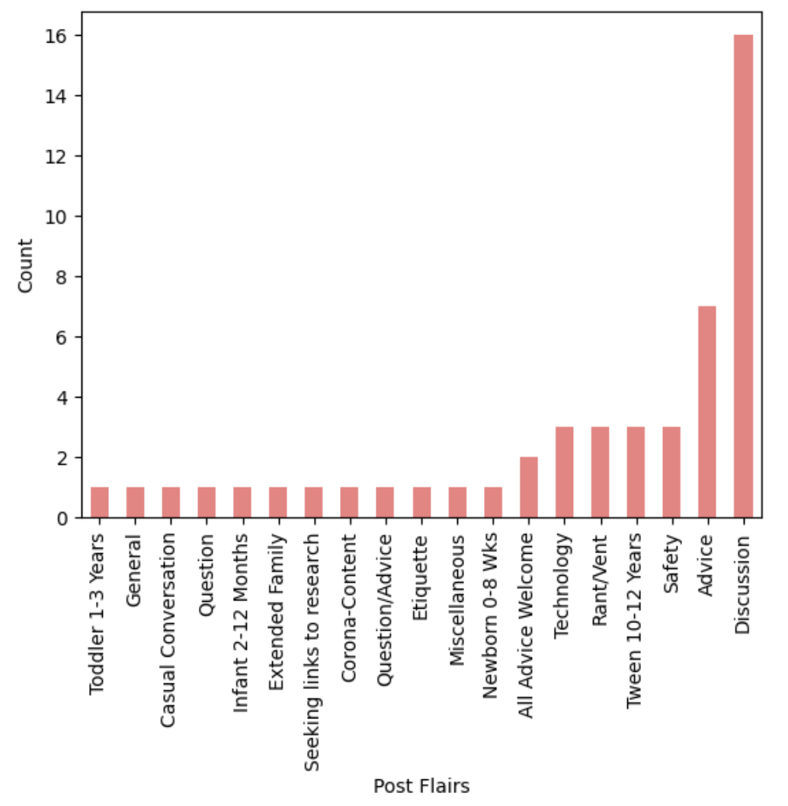
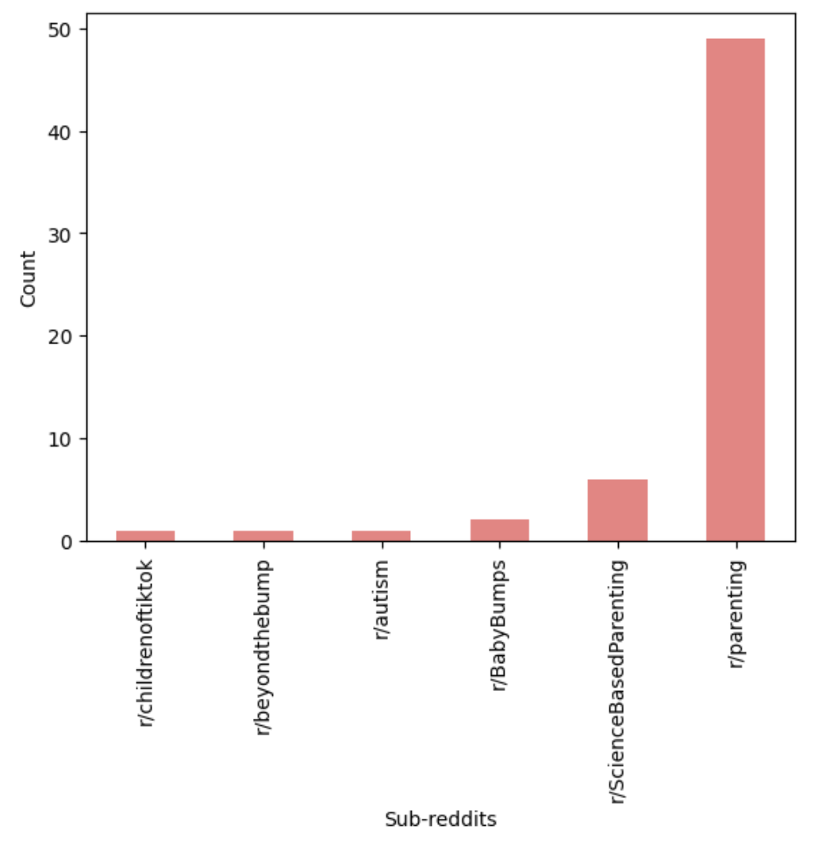
Visualizations

Slide 15
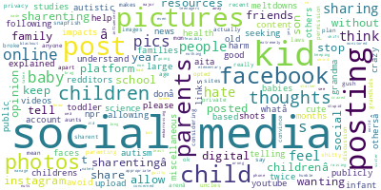
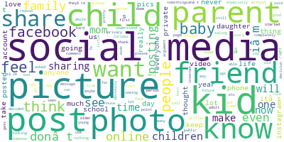
Visualizations
Word cloud of Post headings
Word cloud of Post description

Slide 16
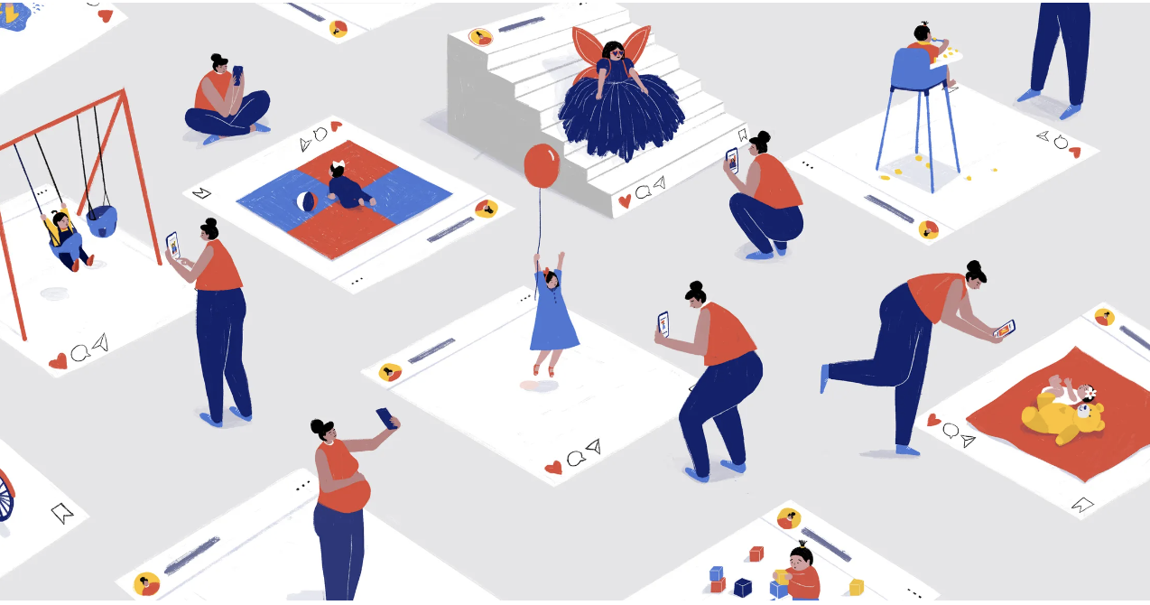
Sharenting as a Social Computing Concept
Sharenting mostly happens on Social Network Sites.
With sharenting parents showcase only positive family aspects.
The pressure to impress omit challenges, creating an unrealistic portrayal.
“we surrender our data and choose not to imagine the worst-case scenarios.”
Credits: Instagram, Facebook, and the Perils of “Sharenting”
Notes:
We came across the concept of self-presentation and interpersonal relationships during week 5 which clearly reflects in the need to share their children’s life online.
Social capital focuses on users’ benefits from social media involvement

Slide 17
Limitations
Future Work
Bias in Online Discussion
Discussions may be influenced by cultural norms.
We are not sure if the contributors are parents or not.
Limited data
Collect more data.
Find more suitable subreddits
More than the concerns that have grown over time we would like to see the suggested solutions to deal with Sharenting
Notes:
Now i’ll go through the limitation of our work. There definitely exists bias in online discussions. The background and the representation of the population is not same as those who use social networking sites and share about their kids.
Some discussions may be influenced by cultural norms. I come south east of the world and we consider a bad omen to share children pictures until they’re old enough. This matters to any conclusions that we make.
Thirdly, we cannot be sure if the user is a parent or not. Just like us researchers, they might be curious about this and want to share their opinion.
Lastly, the data we have is very limited.
Which leads us to, for our future work, we want to collect more data and find more suitable subreddits.
We also want to focus more on the suggested solutions to deal with sharenting than mere pointing out concerns.

Slide 18
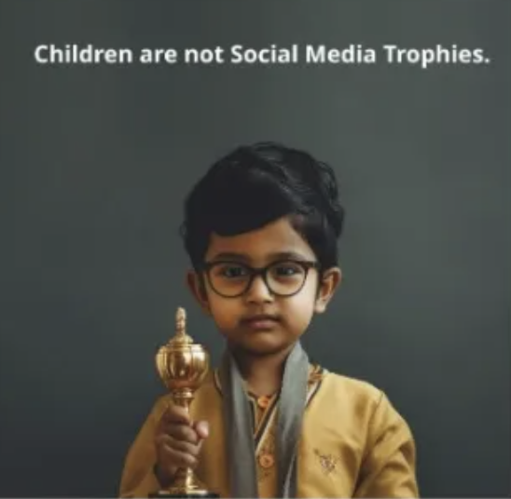
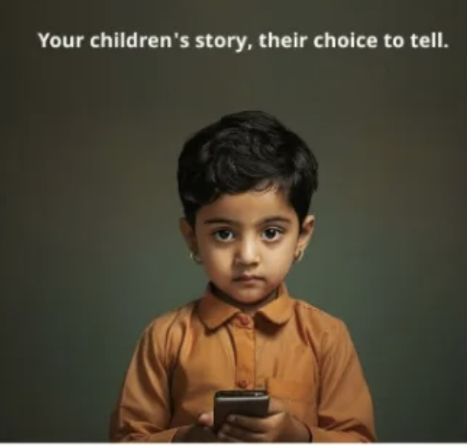
“make more mindful choices” about our digital lives
Notes:
We want to end our presentation by asking parents in the audience to be more mindful about choices on children’s life. Thank you!

